Slide 1
Introduction to Computer Networks 22CS008
Data Link Layer
Lecture10-11 (Theory)
Dr. Htet Ne Oo
Department of Computer Science and Engineering,
Chitkara University, Punjab

Slide 2
Index
,
Types of Errors
Redundancy
Error Detection
Error Correction

Slide 3
TYPES OF ERRORS
Single bit error :-
Only one bit in the data unit has changed.
Burst error :-
It means that two or more bits in the data unit has changed.

Slide 4
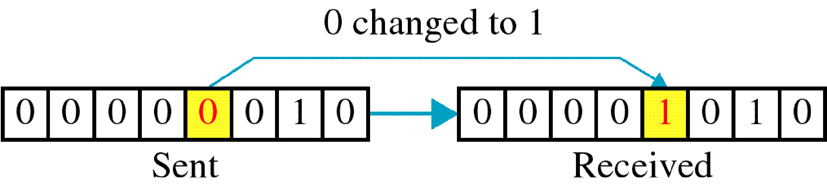
Single-bit error

Slide 5
Basic concepts
Networks must be able to transfer data from one device to another with complete accuracy.
Data can be corrupted during transmission.
For reliable communication, errors must be detected and corrected.
Error detection and correction are implemented either at the data link layer or the transport layer of the OSI model.

Slide 6
Single bit errors are the least likely type of errors in serial data transmission because the noise must have a very short duration which is very rare.
However this kind of errors can happen in parallel transmission.
Example:
If data is sent at 1Mbps then each bit lasts only 1/1,000,000 sec. or 1 μs.
For a single-bit error to occur, the noise must have a duration of only 1 μs, which is very rare.

Slide 7
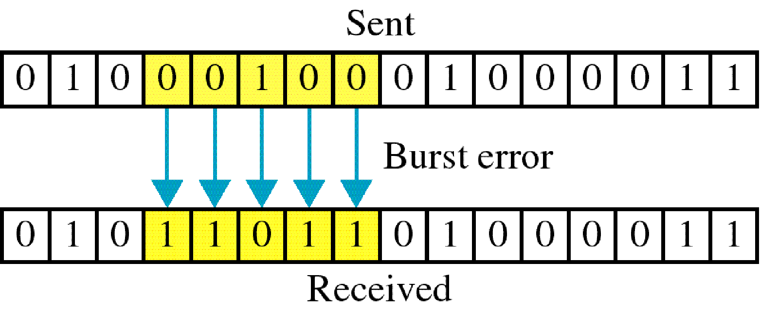
Burst error

Slide 8
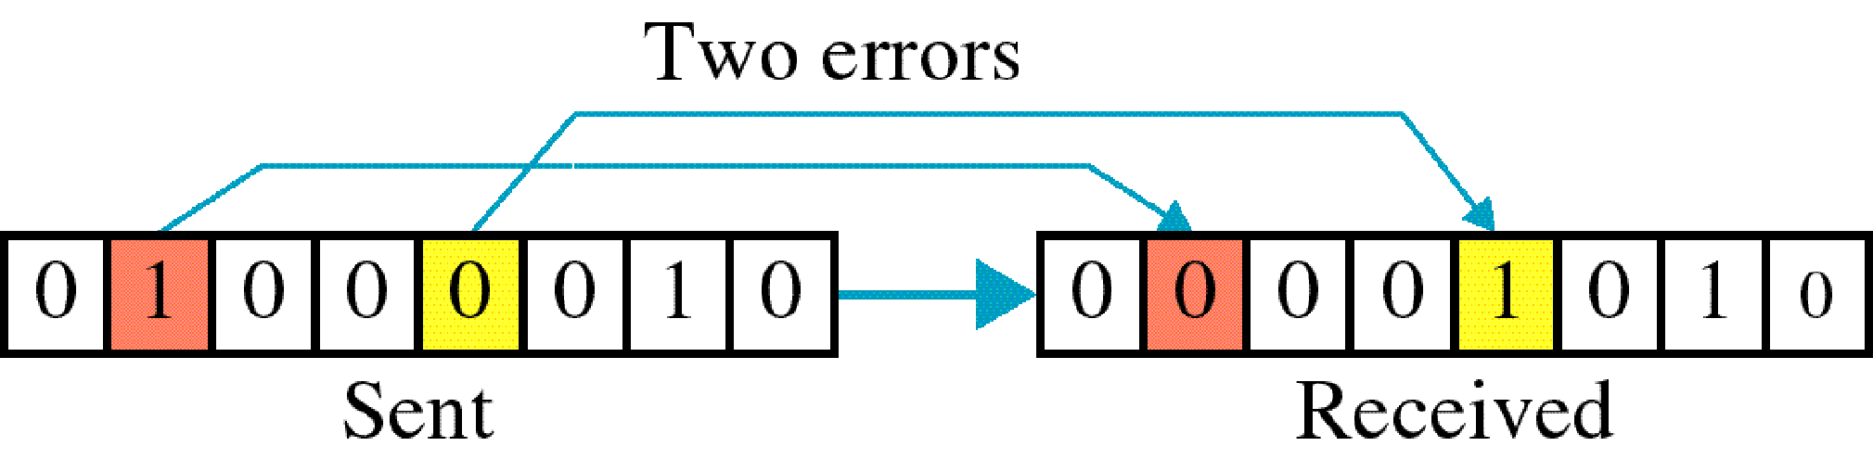

Slide 9
The term burst error means that two or more bits in the data unit have changed from 1 to 0 or from 0 to 1.
Burst errors does not necessarily mean that the errors occur in consecutive bits, the length of the burst is measured from the first corrupted bit to the last corrupted bit. Some bits in between may not have been corrupted.

Slide 10
Data can be corrupted during transmission. For reliable communication, errors must be detected and corrected.
Error detection and correction are implemented either at data link layer or the transport layer of the OSI model.

Slide 11
Burst error is most likely to happen in serial transmission since the duration of noise is normally longer than the duration of a bit.
The number of bits affected depends on the data rate and duration of noise.
Example:
If data is sent at rate = 1Kbps then a noise of 1/100 sec can affect 10 bits.(1/100*1000)
If same data is sent at rate = 1Mbps then a noise of 1/100 sec can affect 10,000 bits.(1/100*10⁶)

Slide 12
Error detection
Error detection means to decide whether the received data is correct or not without having a copy of the original message.
Error detection uses the concept of redundancy, which means adding extra bits for detecting errors at the destination.
Notes:
Make sense of message.
Make sense of message.

Slide 13
Redundancy
Instead of repeating the entire data stream, a shorter group of bits may be appended to the end of each unit.
This technique is called Redundancy because the extra bit are redundant to the information. They are discarded as soon as the accuracy of the transmission has been determined.

Slide 14
There are basically four types of redundancy checks.
1. VRC (Vertical Redundancy Check).
2. LRC (Longitudinal Redundancy Check).
3. CRC (Cyclical Redundancy Check).
4. Checksum

Slide 15
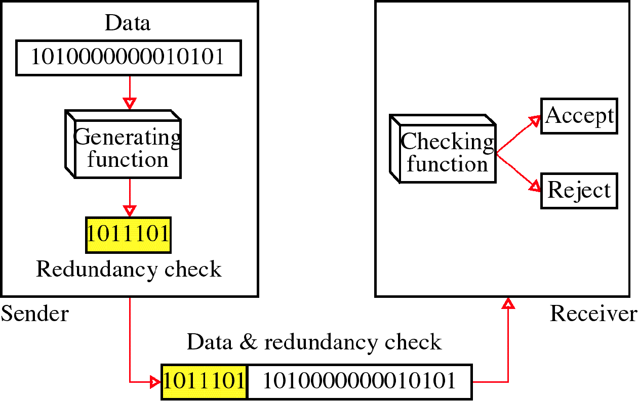
Redundancy

Slide 16
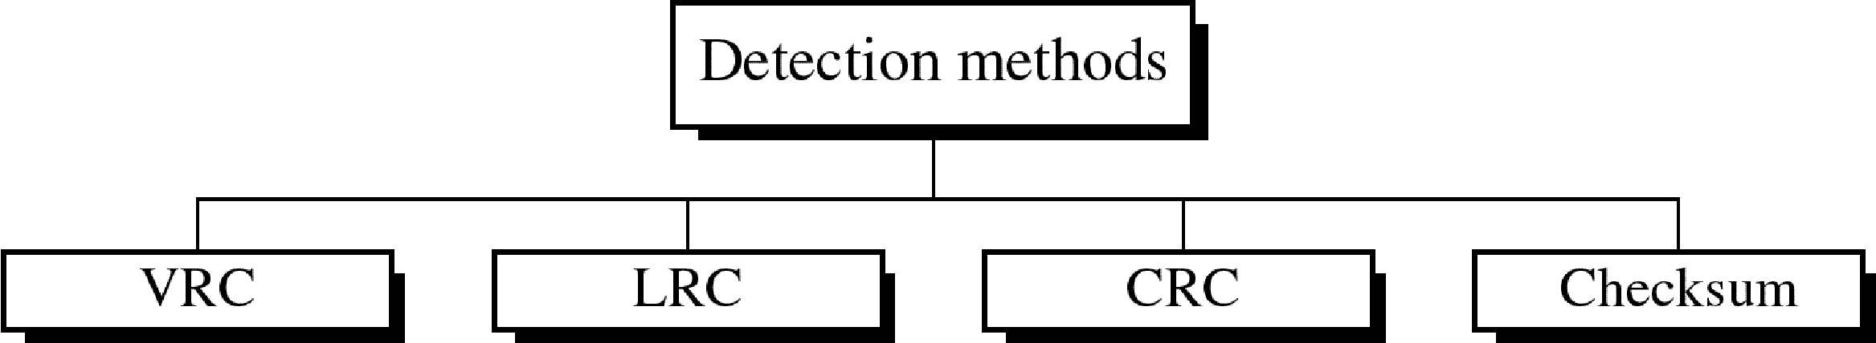
Four types of redundancy checks are used in data communications

Slide 17
Vertical Redundancy Check
It is also known as parity check
It is least expensive mechanism for error detection
In this technique, the redundant bit called parity bit is appended to every data unit so that the total number of 1s in the unit becomes even (including parity bit)
‹#›

Slide 18
Vertical Redundancy Check
1100001 Data
Checking function
Is total number of 1s even ?
Even – parity generator
1100001 | 1
Receiver
1
Sender
‹#›

Slide 19
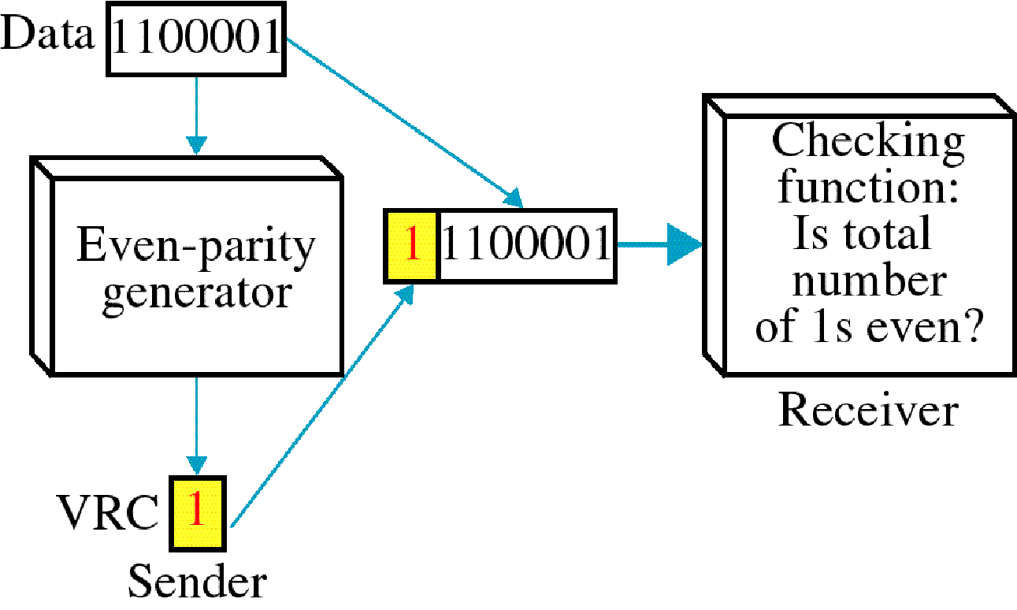
Vertical Redundancy Check VRC

Slide 20
VERTICAL REDUNDANCY CHECK
■
Example :
1110110 1101111 1110010
After adding the parity bit
11101101 11011110 11100100
‹#›

Slide 21
VERTICAL REDUNDANCY CHECK
VRC can detect all single – bit errors
It can detect burst errors if the total number of errors in each data unit is odd.
VRC can not detect errors where the total number of bits changed is even.

Slide 22
Longitudinal Redundancy Check (LRC)
In this method , a block of bits is organized in table(rows and columns)
Calculate the parity bit for each column and the set of this parity bit is also sending with original data.
From the block of parity we can check the redundancy.

Slide 23
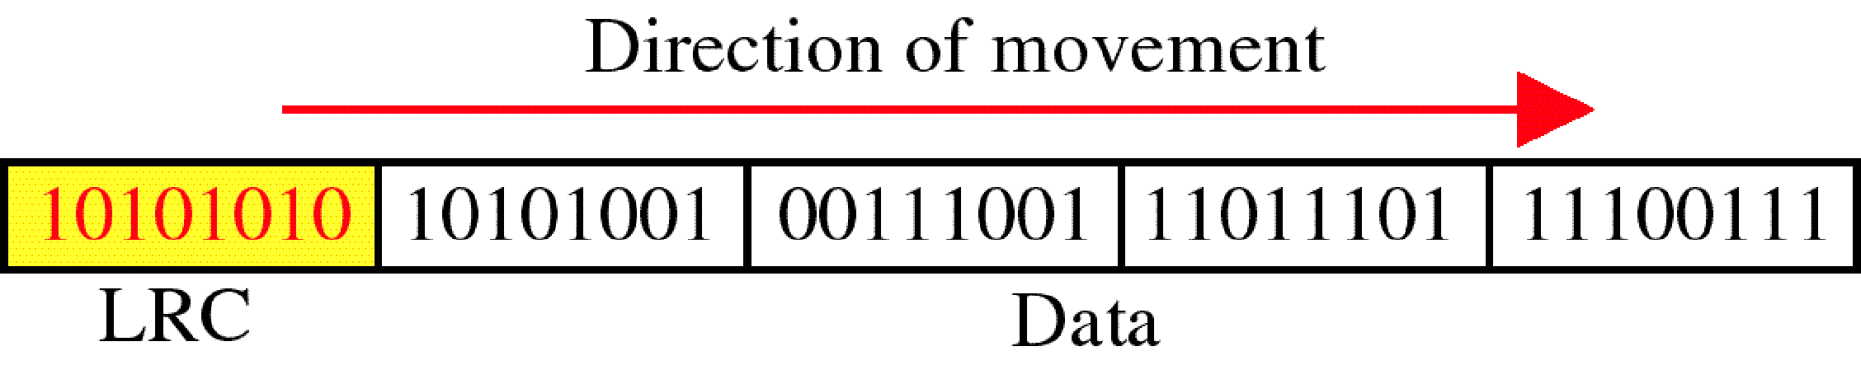
Longitudinal Redundancy Check (LRC)

Slide 24
LRC Example
11100111 11011101 00111001 10101001
11100111
11011101
00111001
10101001
LRC
10101010
11100111 1101101 00111001 10101001 10101010
Original data plus LRC

Slide 25
Suppose the following block is sent :
LRC Example
10101001 00111001 11011101 11100111 10101010
(LRC)
However, it is hit by burst of length eight and some bits are corrupted (Yellow bits are changed) :
10100011 10001001 11011101 11100111 10101010
(LRC)
When the receiver checks the LRC, some of the bits are not following even parity rule and whole block is discarded (the non matching bits are shown in red )
10100011 10001001 11011101 11100111 10101010

Slide 26
Advantage :
LRC of n bits can easily detect burst error of n bits.
Disadvantage :
If two bits in one data units are damaged and two bits in exactly same position in another data unit are also damaged , the LRC checker will not detect the error.

Slide 27
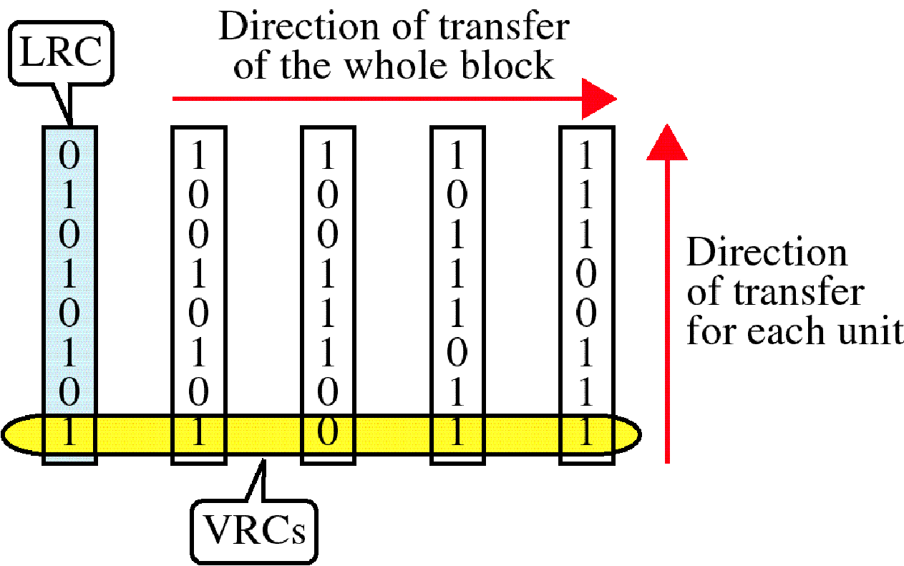
VRC and LRC

Slide 28
Difference between VRC and LRC
S.No. | Vertical Redundancy Check (VRC) | Longitudinal Redundancy Check (LRC)
1. | It stands for Vertical Redundancy Check. | It stands for Longitudinal Redundancy Check.
2. | In this redundant bit called parity bit is added to each data unit. | In this redundant row of bits is added to the whole block.
3. | VRC can detect single bit errors. | LRC can detect burst errors.
4. | It is also known as parity checker. | It is also known as 2-D parity checker.
5. | The advantage of using VRC is that it can checks all single bit errors but can check odd parity only in the case of change of odd bits. | The advantage of using LRC over VRC is that it can check all the burst errors.
6. | It is not capable of checking the burst error in case of change of bits is even. | If two bits in data unit is damaged and also in other data unit the same bits are damaged at same position, then it is not capable of detecting such kind of error.

Slide 29
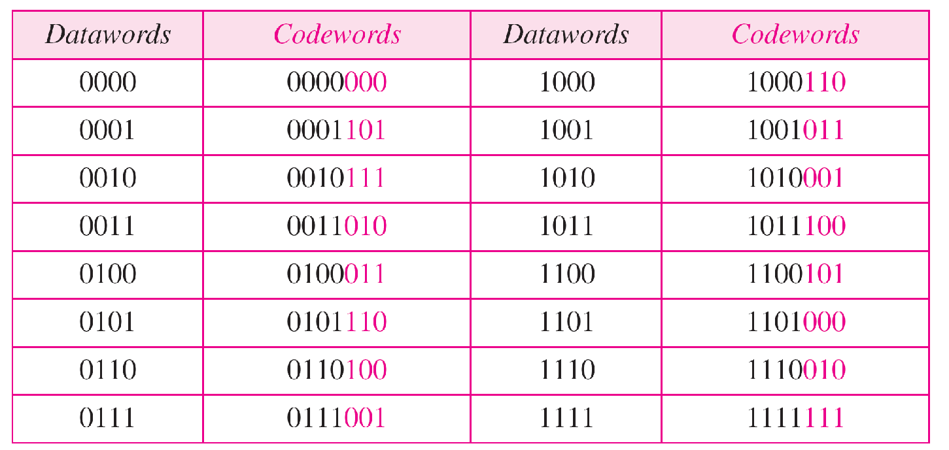
Hamming code C(7, 4) C(n,k) d_{min}=3

Slide 30
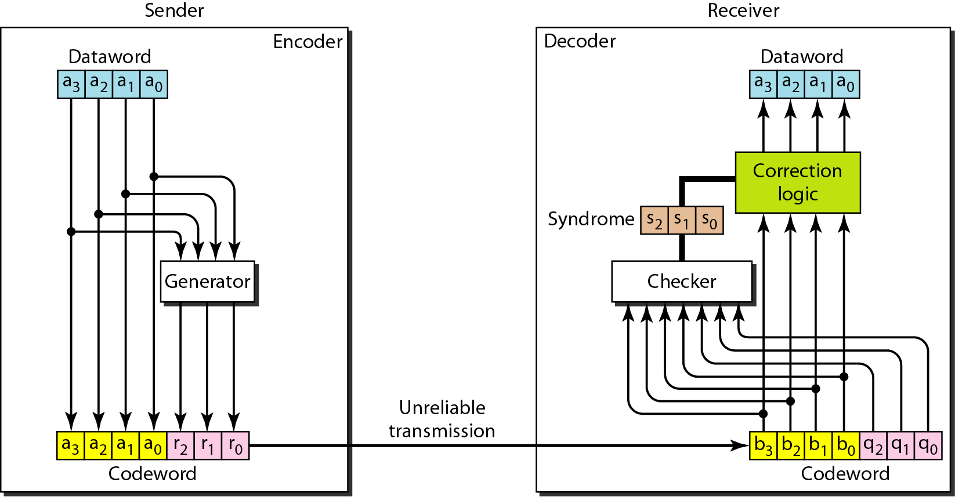
The structure of the encoder and
decoder for a Hamming code

Slide 31
Hamming Code
Parity checks are created as follow (using modulo-2)
r0 = a2 + a1 + a0
r1 = a3 + a2 + a1
r2 = a1 + a0 + a3

Slide 32
Hamming Code
The checker in the decoder creates a 3-bit syndrome (s2s1s0).
In which each bit is the parity check for 4 out of the 7 bits in the received codeword:
s0 = b2 + b1 + b0 + q0
s1 = b3 + b2 + b1 + q1
s2 = b1 + b0 + b3 + q2
The equations used by the checker are the same as those used by the generator with the parity-check bits added to the right-hand side of the equation.

Slide 33
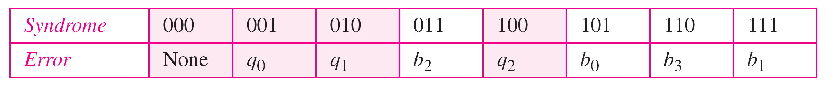
Logical decision made by the correction logic analyzer
Hamming code C(7, 4) can :
detect up to 2-bit error (d_{min} -1)
can correct up to 1 bit error (d_{min}-1)/2

Slide 34
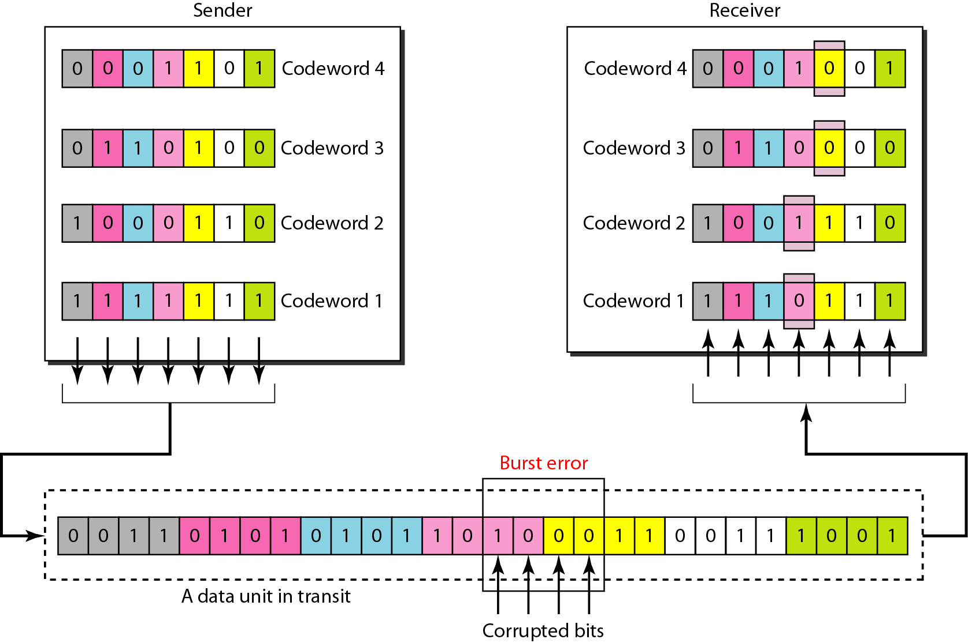
Burst error correction using
Hamming code
Split burst error between multiple codewords

Slide 35

The minimum Hamming distance is the smallest Hamming distance between all possible pairs in a set of words.
Let us find the Hamming distance between two pairs of words.
1. The Hamming distance d(000, 011) is 2
2. The Hamming distance d(10101, 11110) is 3 because

Slide 36
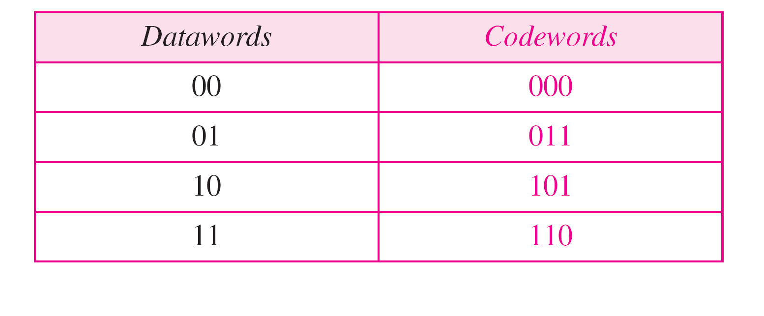
Example
Find the minimum Hamming distance of the coding scheme in Table
Solution
We first find all Hamming distances.
The d_{min} in this case is 2.

Slide 37
Practice Questions
https://pinoybix.org/2017/07/mcq-in-network-layer-internet-protocol-forouzan.html
https://edurev.in/course/quiz/attempt/-1_Test-Ipv4--IP-Packet/0decdb37-7206-4824-afdd-d47013a5c4cd

Slide 38
Thank You

